Slide 1
Final Implementation and Test Results
Project of Implementing Bayesian Matting
Group Name: Dragon Fire
Aparna Sujatha Ramdoss
Jiacheng Li
Yujie Jia
Date 04/04/2024

Slide 2
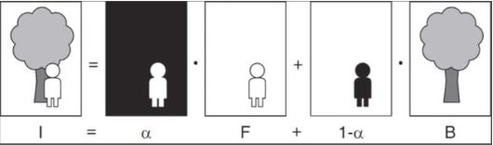
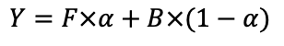
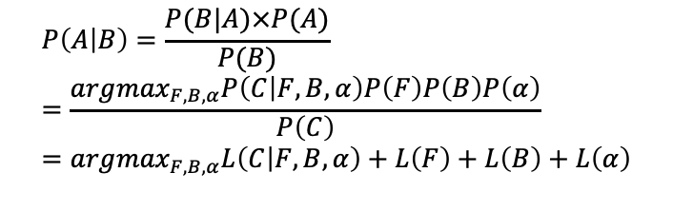
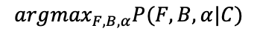
Quick Recap
Bayesian Matting
MAP Estimation
$$arg\max_{F,B,α}P(F,B,α|C)$$
Bayes Theorem
An example of Bayesian Matting
$$P\left(A | B\right)=\frac{P(B|A)×P(A)}{P(B)} \\ =\frac{arg\max_{F,B,α}P\left(C | F,B,α\right)P\left(F\right)P\left(B\right)P\left(α\right)}{P\left(C\right)} \\ =arg\max_{F,B,α}L\left(C | F,B,α\right)+L\left(F\right)+L\left(B\right)+L\left(α\right)$$
$$Y=F×α+B×(1−α)$$
x is the position of the pixel with value I(x). Let 𝛼(x) be the binary matte value at that site. Foreground is indicated by 𝛼 = 1

Slide 3
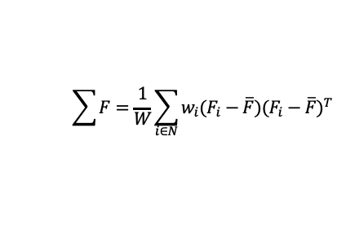
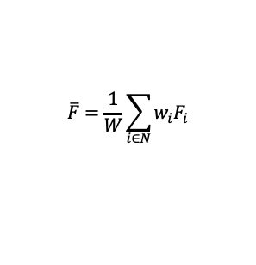
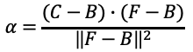
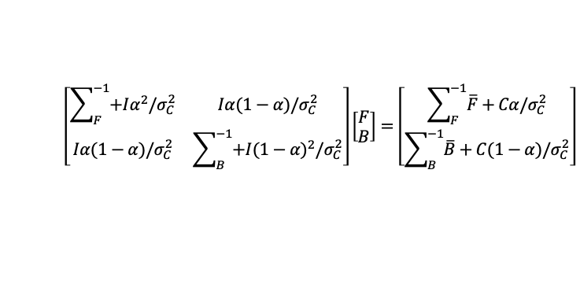
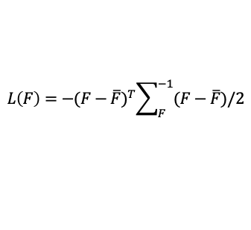
Quick Recap
Bayesian Matting
We assume that 𝛼 is a conxstant. Under this assumption, taking the partial derivatives of log likelihood with respect to F and B and setting them equal to 0 gives:
For each cluster, we calculate the weighted mean color F and the weighted covariance matrix 𝛴F
$$\overline{F}=\frac{1}{W}\sum_{i∈N}{w_{i}F_{i}}$$
$$\left[\begin{matrix}\sum_{F}^{−1}{+Iα^{2}/σ_{C}^{2}} & Iα(1−α)/σ_{C}^{2} \\ Iα(1−α)/σ_{C}^{2} & \sum_{B}^{−1}{+I{(1−α)}^{2}/σ_{C}^{2}}\end{matrix}\right]\left[\begin{aligned}F \\ B\end{aligned}\right]=\left[\begin{aligned}\sum_{F}^{−1}{\overline{F}+Cα/σ_{C}^{2}} \\ \sum_{B}^{−1}{\overline{B}+C(1−α)/σ_{C}^{2}}\end{aligned}\right]$$
$$\sum{F}=\frac{1}{W}\sum_{i∈N}{{w_{i}(F_{i}−\overline{F})(F_{i}−\overline{F})}^{T} }$$
The log likelihoods for the foreground L(F) can then be modeled as being derived from an oriented elliptical Gaussian distribution, using the weighted covariance matrix as follows:
To get 𝛼, let F and B be constant, yielding a quadratic equation in α. We arrive at the solution to this equation by projecting the observed color C onto the line segment FB in color space:
$$L\left(F\right)=−{(F−\overline{F})}^{T}\sum_{F}^{−1}{(F−\overline{F})/2}$$
$$α=\frac{(C−B)∙(F−B)}{{\left\|F−B\right\|}^{2}}$$

Slide 4
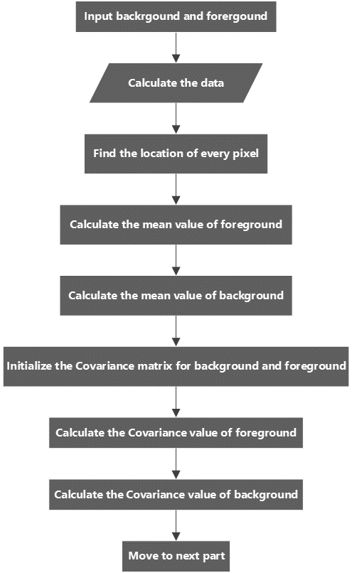
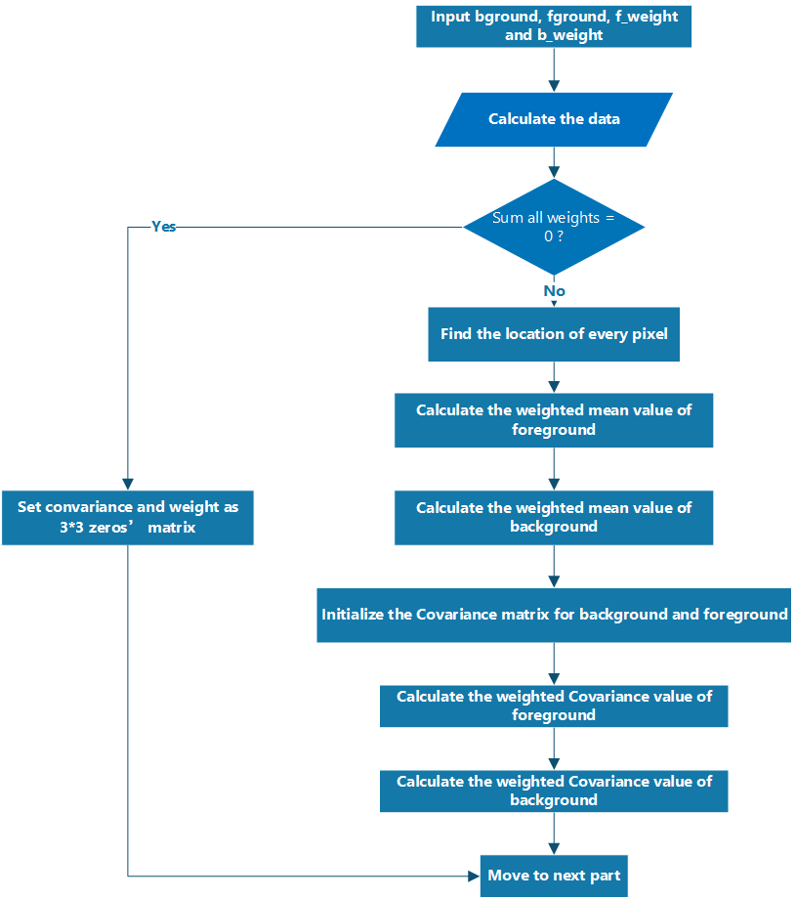
Implementation Comparison
Mathematical Computation
Matlab:
Python:

Slide 5
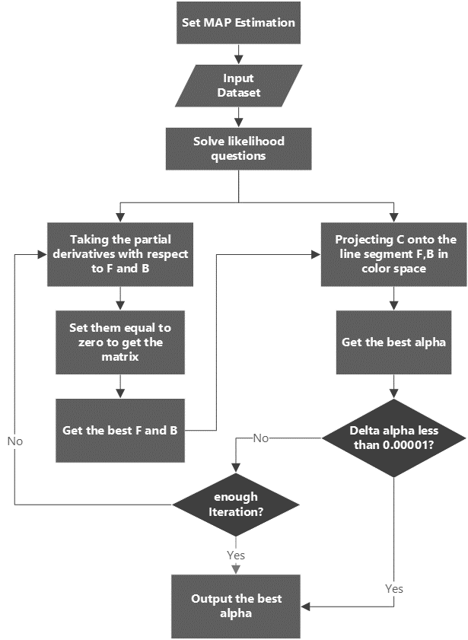
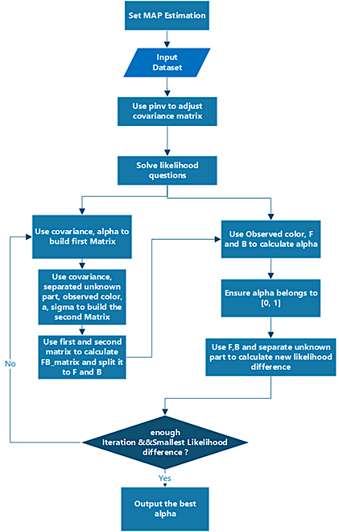
Implementation Comparison
Alpha Calculation
Matlab:
Python:

Slide 6
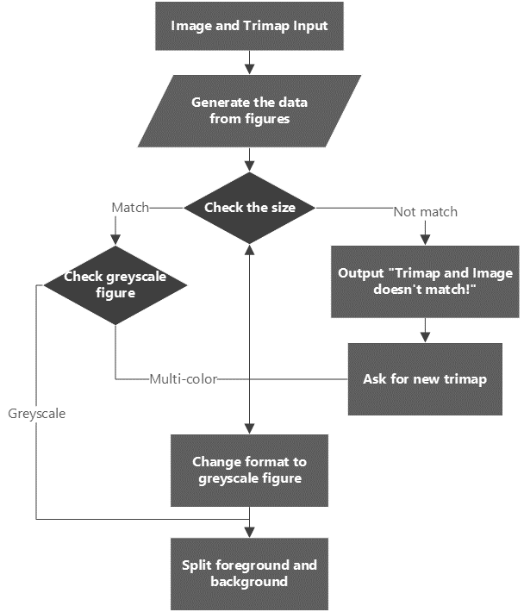
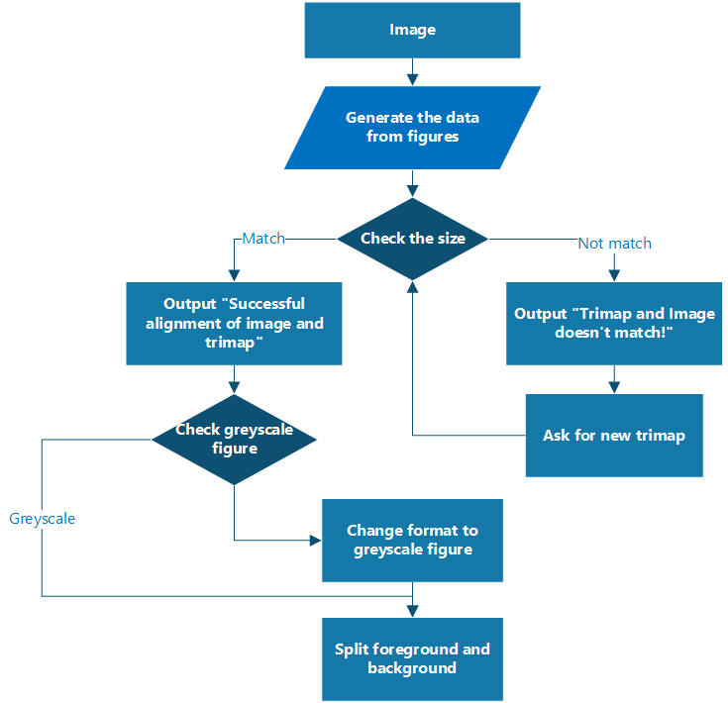
Implementation Comparison
F and B Split
Matlab:
Python:

Slide 7
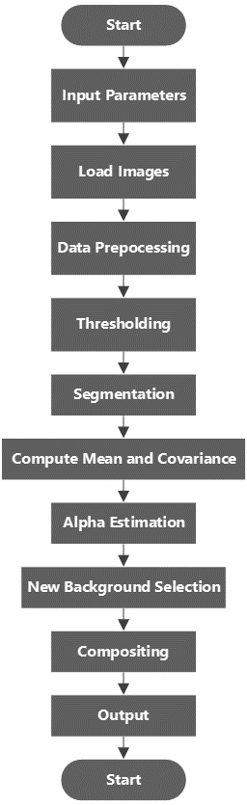
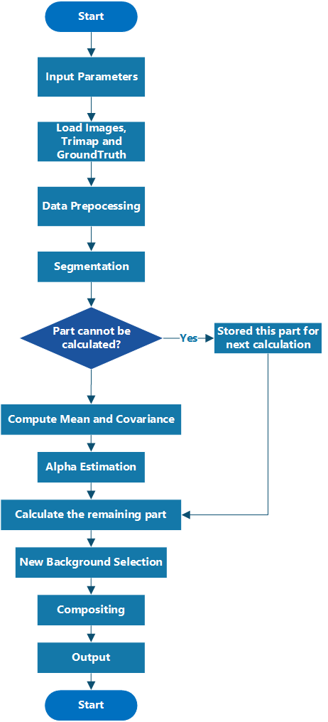
Final Implementation
Matlab:
Python:

Slide 8
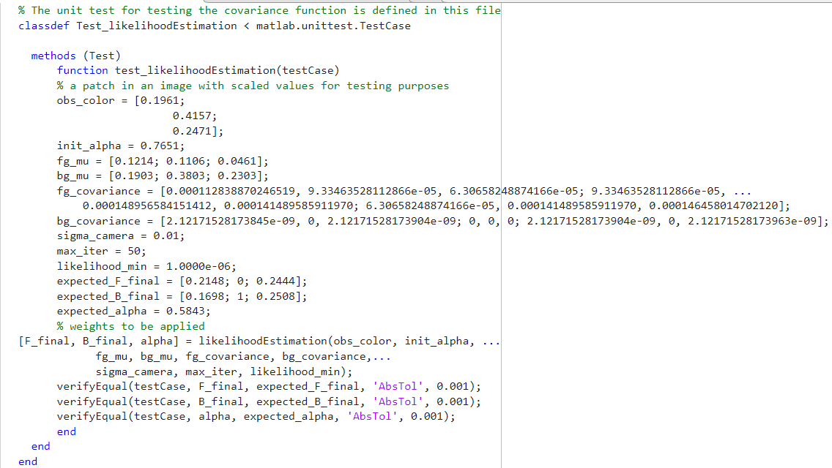
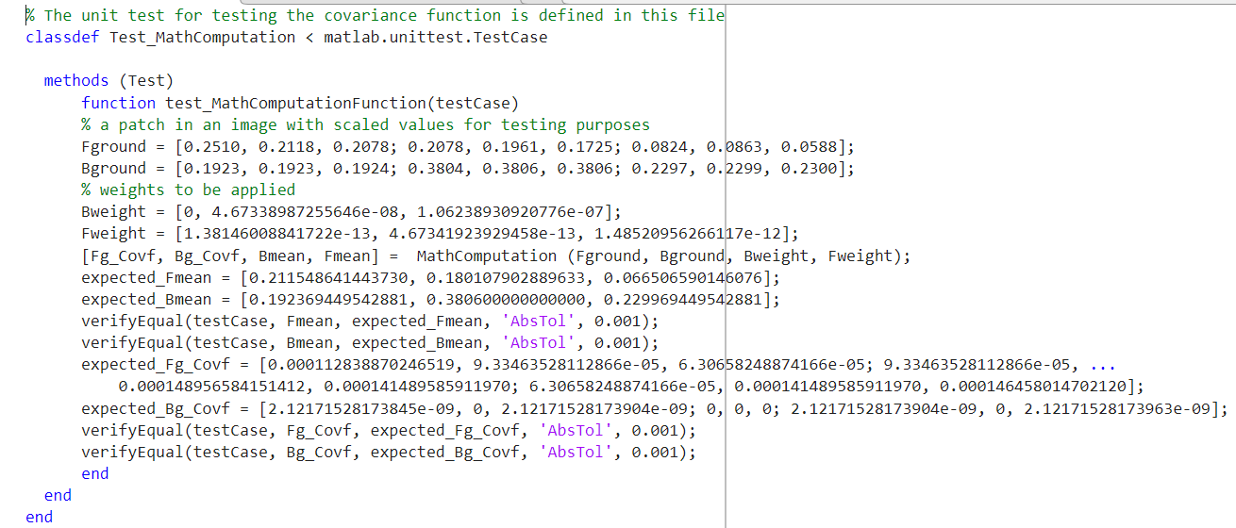
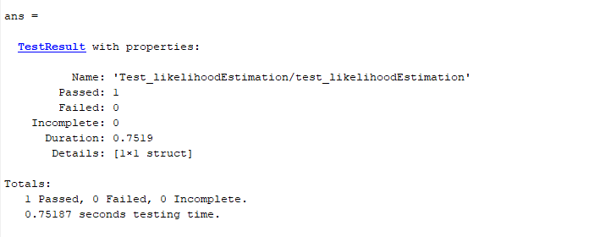
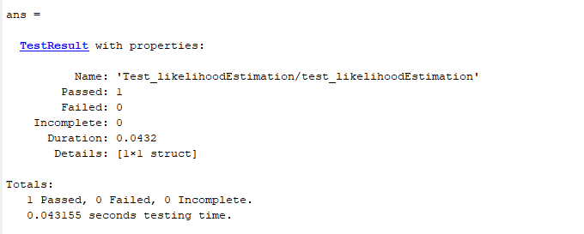
UNIT TEST MATLAB
PASSED!!!
https://ncalculators.com/statistics/covariance-calculator.htm?utm_content=cmp-true#google_vignette

Slide 9
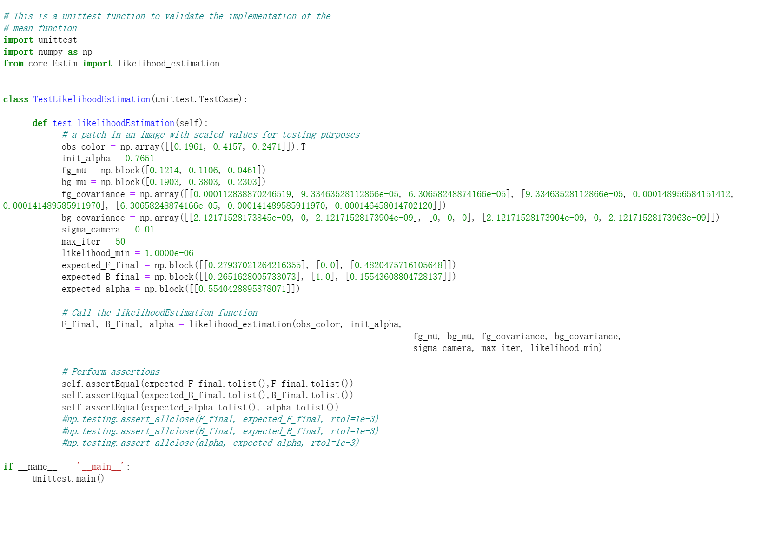
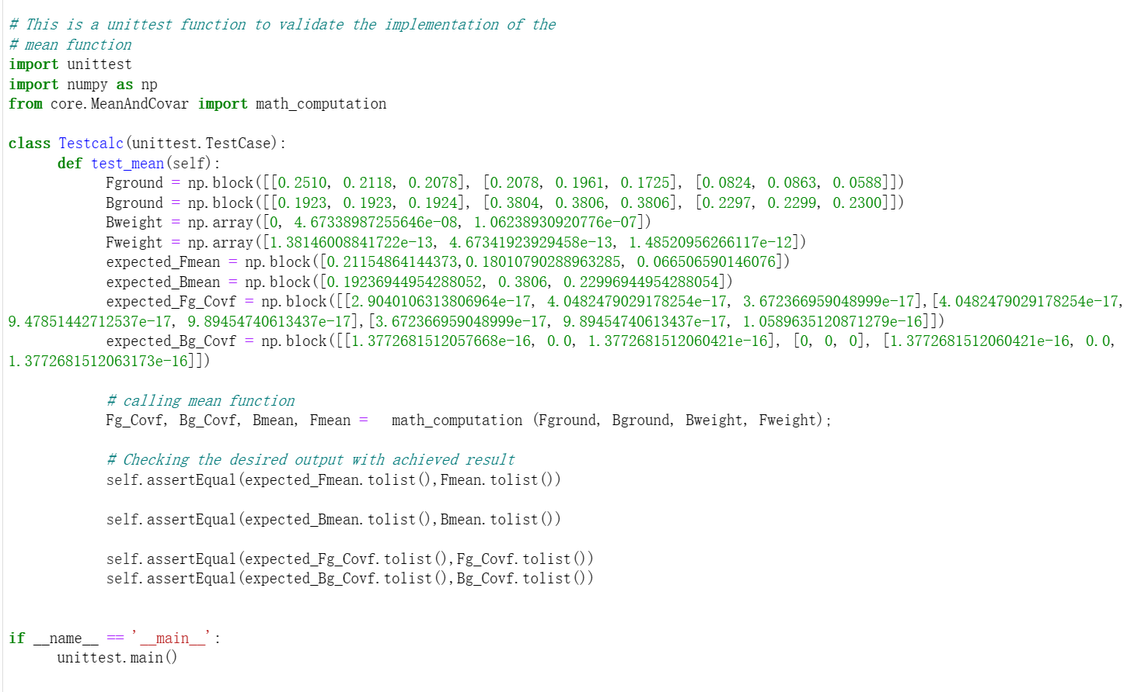
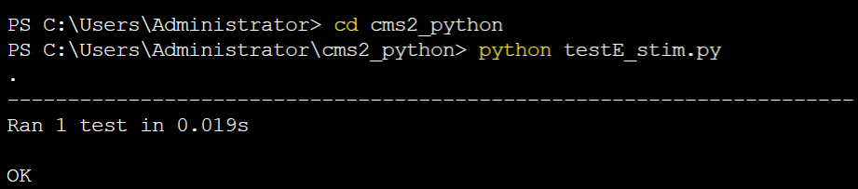
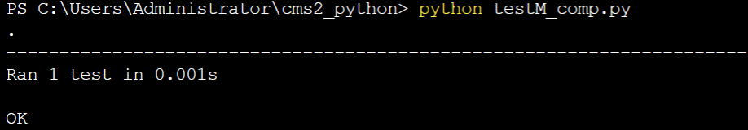
Unit test Python
PASSED!!!

Slide 10


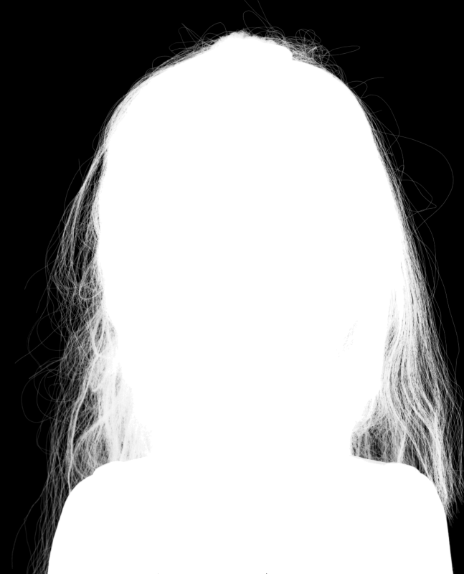

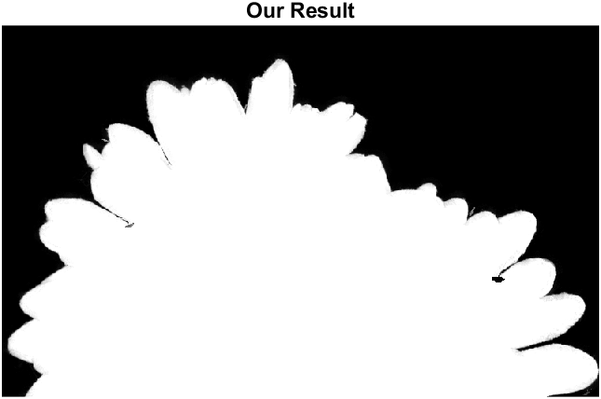
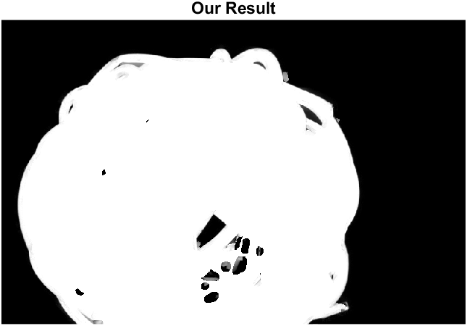
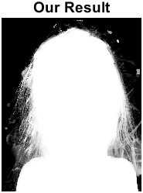
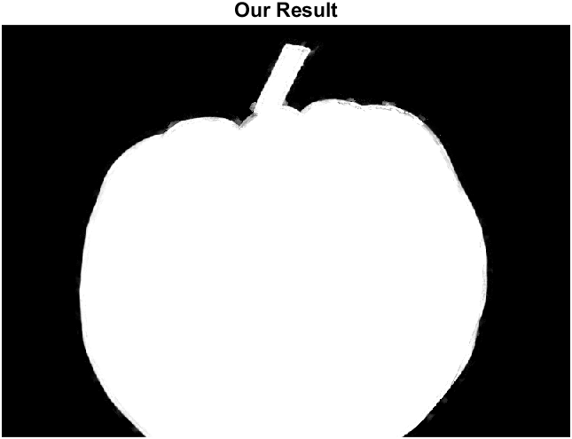
Test Results
MATLAB——Comparison with Bayesian and Laplacian
 | Bayesian Matting |  |  | Laplacian Matting
Pictures | MSE | PSNR | Running Time | MSE | PSNR | Running Time
Flower | 0.0006 | 32.21895 | 28.7546 | 0.04187 | 13.78147 | 0.11465
Coil | 0.01217 | 19.1484 | 69.8519 | 0.03814 | 14.18635 | 0.11717
Doll | 0.01717 | 17.65264 | 168.7496 | 0.15603 | 8.06799 | 0.14342
Pumpkin | 0.00052 | 32.86391 | 17.0989 | 0.02734 | 15.6315 | 0.14421

Slide 11

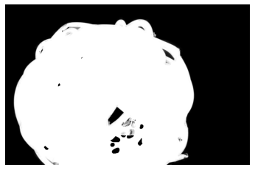
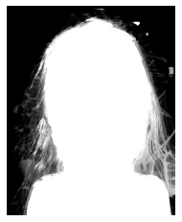
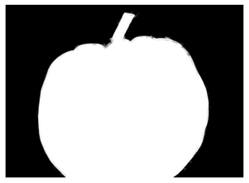
Test Results
Python
Bayesian Matting
Pictures | MSE | PSNR | SSIM | Running Time
Flower | 0.00085 | 30.72637 | 0.97943 | 94.7253
Coil | 0.01156 | 19.3704 | 0.94258 | 145.4868
Doll | 0.01717 | 17.65264 | 0.85194 | 168.7496
Pumpkin | 0.00052 | 32.86391 | 0.9799 | 60.2205

Slide 12


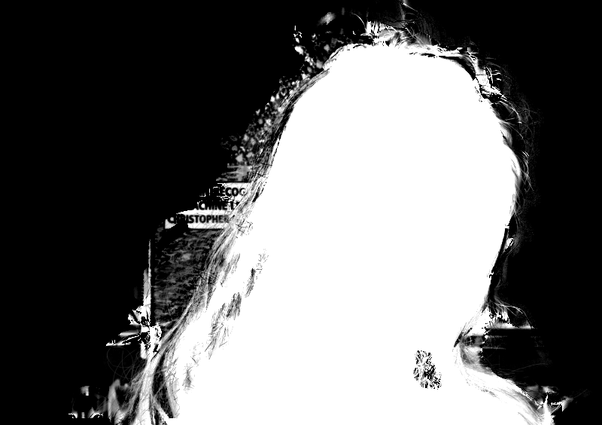
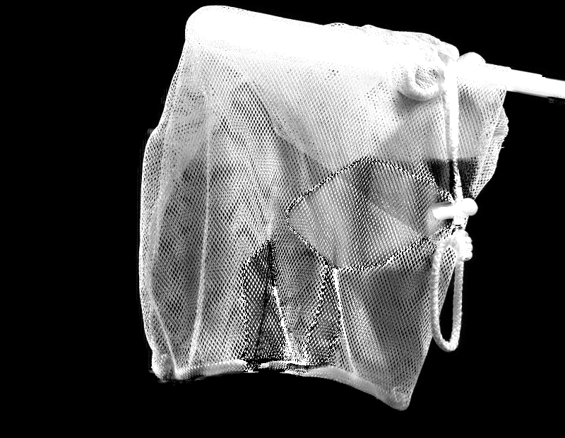
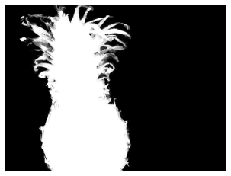

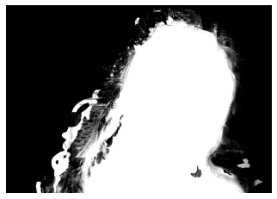
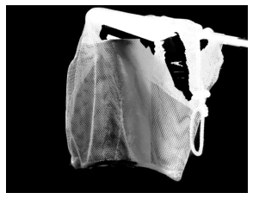
Test comparison with visual Benchmark
Transparent: Little, Medium, Strong, High
Pineapple
Elephant
Doll
Net
GT
Ours
Objects photographed in front of a natural 3D scene
Objects photographed in front of a monitor showing natural images

Slide 13

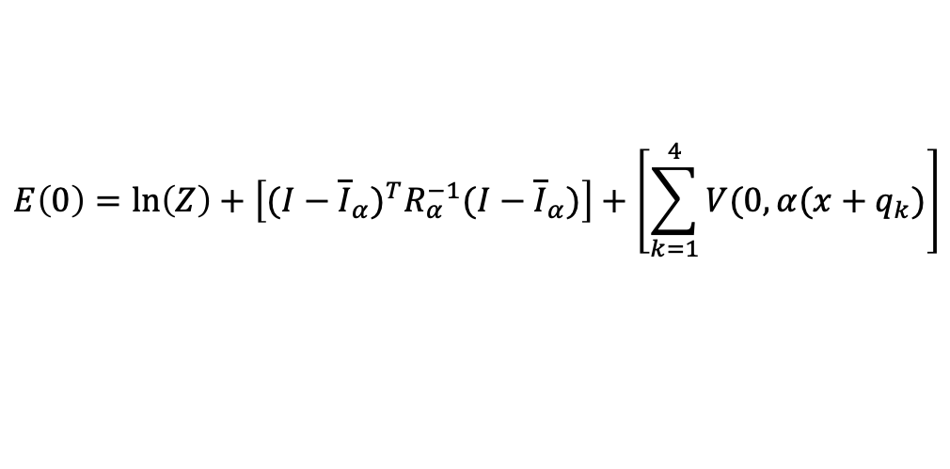
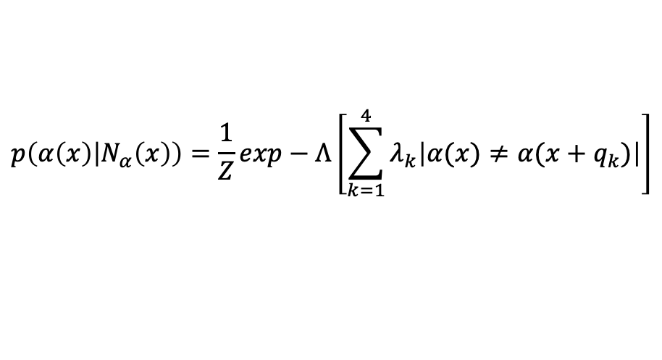
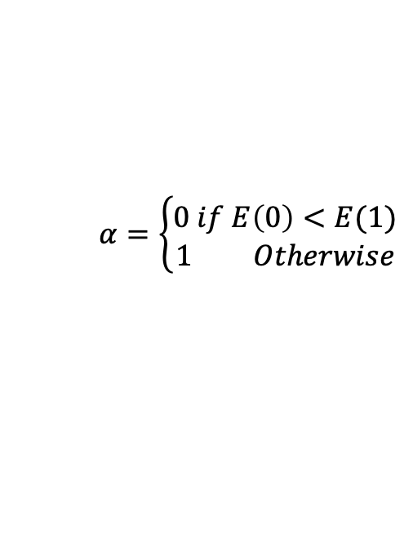
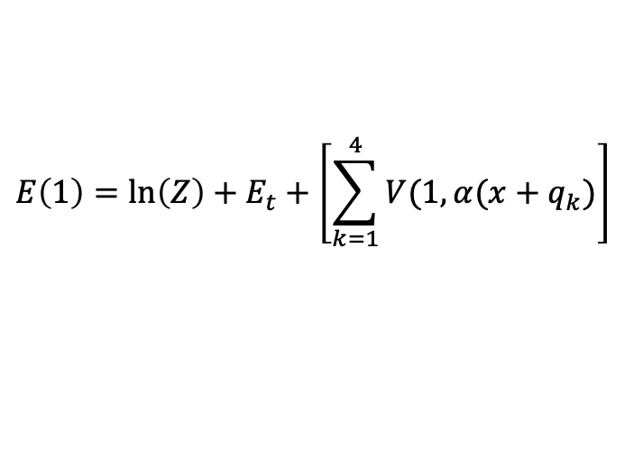
MRF(Markov Random Field)
Strategy for smoothness
$$p\left(α\left(x\right) | N_{α}\left(x\right)\right)=\frac{1}{Z}exp−Λ\left[\sum_{k=1}^{4}{λ_{k}\left|α(x)≠α(x+q_{k})\right|}\right]$$
Potential Energy Function
$$E\left(0\right)=\ln\left(Z\right)+\left[{(I−{\overline{I}}_{α})}^{T}R_{α}^{−1}(I−{\overline{I}}_{α})\right]+\left[\sum_{k=1}^{4}{V(0,α(x+q_{k})}\right]$$
$$E\left(1\right)=\ln\left(Z\right)+E_{t}+\left[\sum_{k=1}^{4}{V(1,α(x+q_{k})}\right]$$
$$α=\left\{\begin{aligned}0 if E\left(0\right)<E(1) \\ 1 Otherwise\end{aligned}\right.$$
We assume that the foreground color is sampled from a uniform distribution

Slide 14
MRF(Markov Random Field)
Strategy for smoothness
Unlike Bayesian matting, which often assumes independence between pixels, MRF considers spatial relationships between neighboring pixels.
MRF can capture global image properties and coherence better than Bayesian matting.
MRF offers efficient optimization algorithms, such as graph cuts or belief propagation, for solving the matting problem.
MRF matting involves manually partitioning images which will help us in F and B split where find details such as hair or intricate backgrounds.

Slide 15

Difficulties we met
Technical
General
Understanding the research paper
Warnings when dealing with mathematical equations
Producing a correct tri-map
Computational load
Resolving accuracy
Schedule arrangement
Roles

Slide 16
References
Chuang, Yung-Yu, et al. "A bayesian approach to digital matting." Proceedings of the 2001 IEEE Computer Society Conference on Computer Vision and Pattern Recognition. CVPR 2001. Vol. 2. IEEE, 2001.
Sindeyev, Mikhail, Vadim Konushin, and Vladimir Vezhnevets. "Improvements of Bayesian matting." proc. of Graphicon. 2007.
Azencott, Robert. "Image analysis and Markov fields." Proc. ICIAM’87 (1988): 53-61.

Slide 17
Thank You

